Slide 1
Introduction to Software Security

Slide 2
About me
Dharshana Kasthurirathna
Senior Lecturer at Faculty of Computing, SLIIT (6th floor, main building)
dharshana.k@sliit.lk
dka@ucsc.cmb.ac.lk

Slide 3
Course Objectives
Understand the principles of software security.
Recognize the importance of secure software development.
Explore common software vulnerabilities and their impact.

Slide 4
What is Software Security?
Definition: Protecting software against unauthorized access, use, disclosure, disruption, modification, or destruction.
Goal: Ensure confidentiality, integrity, and availability (CIA triad).

Slide 5
Secure Software?
“Reliable software does what it is supposed to do. Secure software does that and nothing else” (Ivan Arce)

Slide 6
Key Principles of Software Security
Confidentiality: Ensuring data is accessible only to authorized users.
Integrity: Ensuring data remains unaltered during storage or transmission.
Availability: Ensuring software and systems are operational when needed.

Slide 7
Why is Software Security Important?
Increasing reliance on software in critical systems.
Rising number of cyberattacks targeting software vulnerabilities.
Real-world consequences of insecure software (e.g., data breaches, financial loss).

Slide 8
Challenges in Software Security
Rapid development cycles (DevOps and Agile).
Complex software ecosystems.
Lack of awareness and training.
Insider threats.

Slide 9
Common Software Security Threats
Malware (viruses, ransomware, spyware).
Phishing and social engineering attacks.
Exploitation of vulnerabilities (e.g., buffer overflows, SQL injection).
Supply chain attacks.

Slide 10
Common Vulnerabilities
OWASP Top 10 vulnerabilities:
Injection (SQL, command, etc.).
Broken Authentication.
Sensitive Data Exposure.
Security Misconfiguration.
Cross-Site Scripting (XSS).

Slide 11
Software Security vs. Application Security
Application Security
A way to defend against software exploit after the deployment is complete
Issue-based short-term approach
Penetrate and Patch
Reactive
Software Security
A way to defend against software exploits by building software to be secure
Holistic long-term approach
Root Cause Analysis
Organizational Change

Slide 12
Software security vs Application security
Software security – Broader scope, OS/Middleware/Applications
Application security – Narrower scope, Applications (web/mobile)

Slide 13
Common Practices in Application Security
Do a Security Assessment once development is finished
Yearly Penetration Tests and Vulnerability Assessments.
Mainly just to comply with standards.
Vulnerability Assessment
- The process of identifying and quantifying vulnerabilities in an environment
Penetration Test
- Simulates the actions of an external and/or internal attacker
- Aims to breach the security of the organization

Slide 14
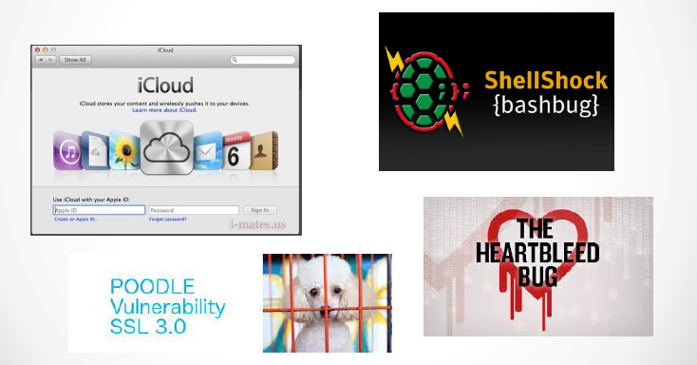
https://bgr.com/2016/03/16/jennifer-lawrence-nudes-icloud-hack/
https://www.theguardian.com/technology/2018/sep/28/facebook-50-million-user-accounts-security-berach
https://www.zdnet.com/article/facebook-could-face-billions-in-fines-under-gdpr-over-latest-data-breach/
https://www.crn.com/news/security/10-major-cyberattacks-and-data-breaches-in-2023
https://www.csoonline.com/article/562691/stuxnet-explained-the-first-known-cyberweapon.html
https://en.wikipedia.org/wiki/Stuxnet

Slide 15
Issues with security breaches
Immediate financial loss
Reputation
Lawsuits
Regulatory penalties (e.g., GDPR fines).
National security issues
Discussion: Can security be quantified?

Slide 16
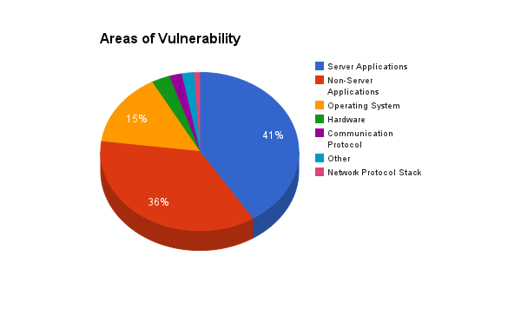
Source : NIST 2011

Slide 17
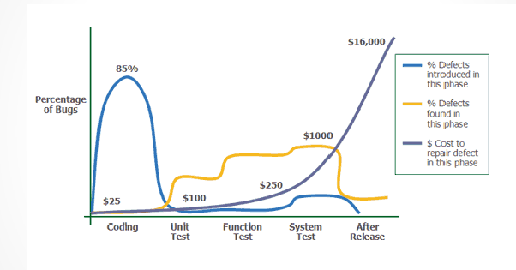
Cost of fixing bugs
Applied Software Measurement, Capers Jones, 1996 https://espincorp.wordpress.com/tag/cost-to-fix-bugs/

Slide 18
Why application security is not good enough?
Applying and managing security patches may be costly
0-day vulnerabilities
Patches may not fix the cause
Firewalls and IDSs may not be sufficient
Build security in!

Slide 19
Build Security In
"Organizations that have focused on security in the early stages have seen major reductions in operational vulnerabilities, resulting in reductions in software patching. Our research from one case study showed that the cost to fix requirement problems identified later in the project cost close to $2.5 million; the cost to fix these problems early in the lifecycle was $0.5 million. In addition, Microsoft's own data show that when security was considered throughout the Windows Vista development lifecycle, vulnerabilities were reduced by 45%"
Refer: http://www.cert.org/cybersecurity-engineering/index.cfm#swamodel

Slide 20
Secure Software Development Lifecycle (S-SDLC)
Make security a mandatory part in every phase of software development

Slide 21
Secure Software Development Lifecycle (SDLC)
Integration of security in every phase of SDLC:
Requirements
Design
Implementation
Testing
Deployment
Maintenance

Slide 22
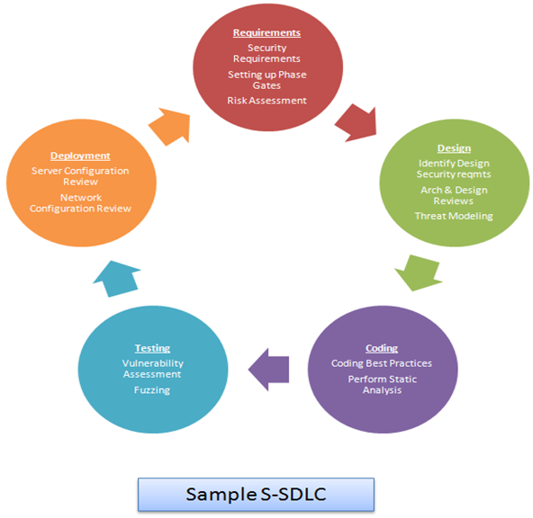
Secure Software Development Lifecycle (S-SDLC)
https://resources.infosecinstitute.com/intro-secure-software-development-life-cycle/

Slide 23
Threat Modeling Basics
Definition: Identifying and prioritizing potential threats.
Frameworks: STRIDE, DREAD.
Example: Modeling threats for a banking application.

Slide 24
Secure Coding Practices
Avoid hardcoding sensitive information.
Validate input data.
Use parameterized queries to prevent SQL injection.
Regularly update dependencies and libraries.

Slide 25
Vulnerability Management
Tools for vulnerability scanning (e.g., Nessus, OWASP ZAP).
Patch management practices.
Importance of security audits.

Slide 26
Importance of Security Testing
Types:
Static Application Security Testing (SAST).
Dynamic Application Security Testing (DAST).
Interactive Application Security Testing (IAST).
Automated vs. Manual Testing.

Slide 27
How to implement a S-SDLC
Security policies and procedures
Get the support of all project stakeholders
Proper incident management policies
- From Senior Management to the users
User training

Slide 28
How to Implement a S-SDLC…
Focus attention on architecture as much as on bugs
Provide Security training for everyone who are directly involved in SDLC
Requirements Engineer, Software Architect, Designer, Developer, Software Quality Manager, Software Tester, Project Manager
Get the involvement of senior executives and middle management
Clients can sign SLA asking for security from application vendors

Slide 29
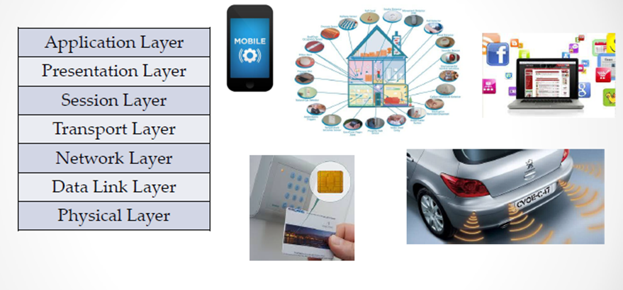
Software Security – Where does it fit in?
https://www.youtube.com/watch?v=KG4F5xKqNf4

Slide 30
Aspects of Software Security
Code Level Security, User Input Verification
Differences in Programming Languages and Operating Systems and how it affects Software Development
Cryptography
Access Control Mechanisms
Security on data-at-rest
Security on data-transport (Security Protocols such as SSL/TLS)
Penetration Testing and Vulnerability Assessments

Slide 31
Is Software Security Costly?
Yes, if you only look at the cost from requirement capture to ship.
NO, if you are considering total cost which includes requirement capture to ship and the cost associated after deployment such as fixing bugs, doing revisions, etc.

Slide 32
Software Security
Engineering Software so that it continues to function correctly even under malicious attack
Build Security In is a collaborative effort that provides practices, tools, guidelines, rules, principles, and other resources that software developers, architects, and security practitioners can use to build security into software in every phase of its development.

Slide 33
Example
WSO2 Security engineering guidelines
https://wso2.com/technical-reports/wso2-secure-engineering-guidelines

Slide 34
Real-World Examples of Software Security Breaches
SolarWinds supply chain attack.
Equifax data breach.
WannaCry ransomware attack.
Discussion: What went wrong?

Slide 35
Runtime Application Security
Runtime Application Self-Protection (RASP): Real-time protection against attacks.
Memory protection (ASLR - Address Space Layout Randomization, DEP - Data Execution Prevention).
Sandboxing and container security.

Slide 36
Overview of Software Security Standards
OWASP (Open Web Application Security Project).
ISO/IEC 27001: Information Security Management.
NIST Cybersecurity Framework.

Slide 37
Cryptography in Software Security
Role of cryptography in securing data.
Symmetric vs. asymmetric encryption.
Examples: AES, RSA

Slide 38
Regulatory and Compliance Requirements
GDPR (General Data Protection Regulation).
HIPAA (Health Insurance Portability and Accountability Act).
PCI-DSS (Payment Card Industry Data Security Standard).

Slide 39
Emerging Trends in Software Security
Zero Trust Architecture (ZTA).
Security in AI-driven applications.
Post-quantum cryptography.

Slide 40
Summary of Key Takeaways
Software security is critical to modern systems.
Common vulnerabilities can have severe consequences.
Secure development practices and regular testing are essential.

Slide 41
Discussion Questions
What are some examples of insecure software you have encountered?
How can developers balance speed and security?

Slide 42
Sample answers
1. What are some examples of insecure software you have encountered?
- Applications that allow weak passwords such as 123456
- Websites that send passwords or personal data without encryption
- Systems that do not log users out after long periods of inactivity
- Mobile apps requesting unnecessary permissions
- Software with outdated libraries and unpatched vulnerabilities
- Applications that reveal detailed error messages, database information, or system paths
- Systems without proper access control, allowing users to view or modify other users’ data

Slide 43
Sample answers
2. How can developers balance speed and security?:
- Define essential security requirements early
- Use secure frameworks, libraries, and reusable components
- Automate code scanning, dependency checks, and security testing
Prioritize high-risk vulnerabilities first
- Apply secure coding standards and peer reviews
- Use threat modelling for important features
- Release software in small, tested increments
- Avoid delaying critical security fixes for delivery deadlines
₋

Slide 44
References
OWASP Foundation (https://www.owasp.org).
NIST Cybersecurity Framework (https://www.nist.gov/cyberframework) .
https://www.blackhat.com/presentations/bh-usa-06/bh-us-06-Morana-R3.0.pdf
Real-world case studies (e.g., SolarWinds, Equifax).

